Slide 1
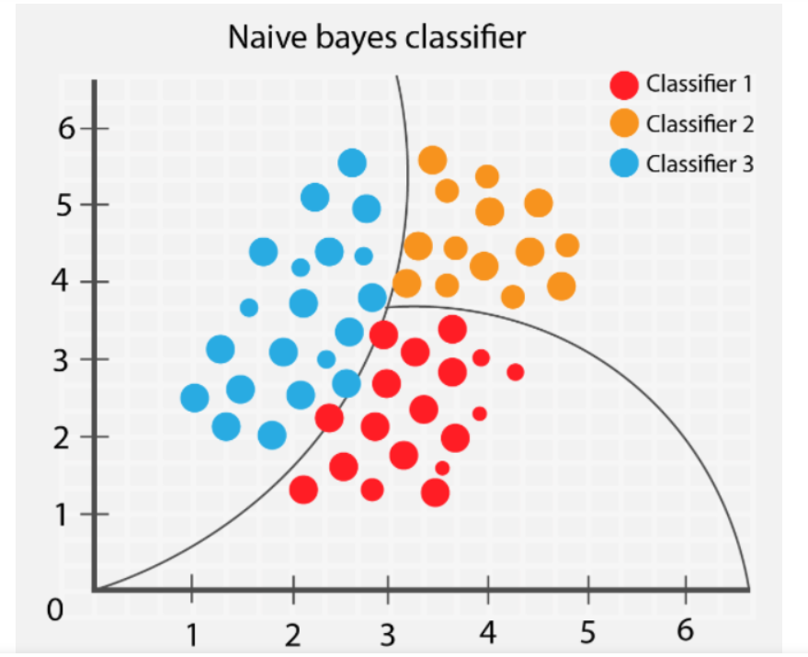
Naive Bayes Classifier

Slide 2

Agenda
What is Naïve bayes?
Naïve bayes and Machine learning
Understanding Naïve bayes classifier
Advantages of naïve bayes
Hyperparameters tuning
Demo

Slide 3
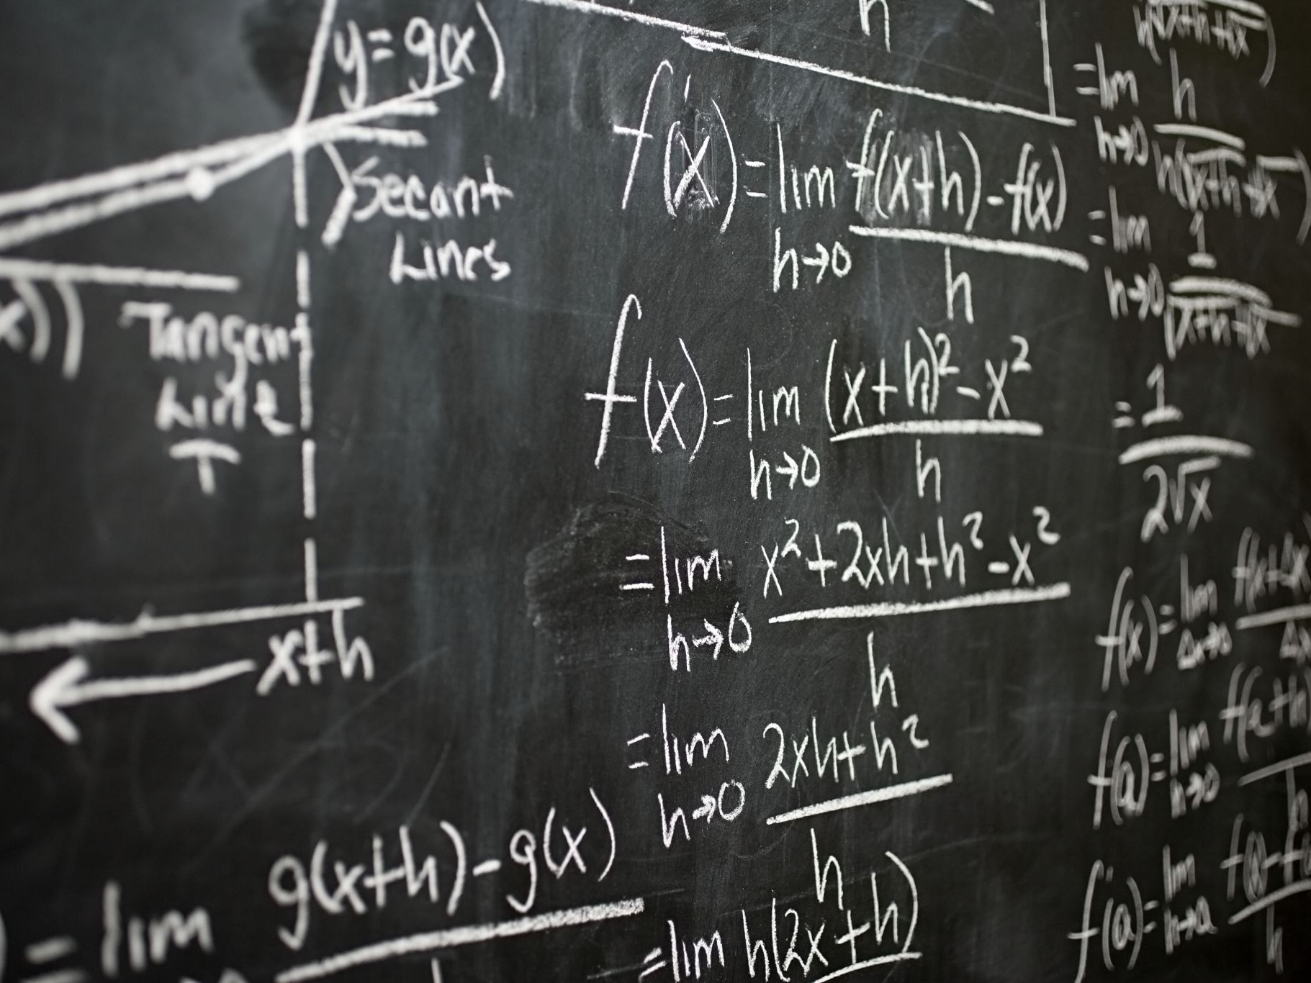
How
Bayesian inference
Works

Slide 4
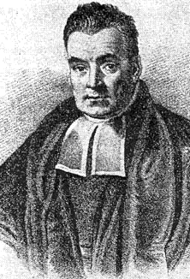
What does “Bayesian inference” even mean?
Inference = Educated guessing
Thomas Bayes = A nonconformist Presbyterian minister in London back when the United States were still The Colonies.
He also wrote an essay on probability. His friend Richard Price edited and published it after he died.
Bayesian inference = Guessing in the style of Bayes

Slide 5
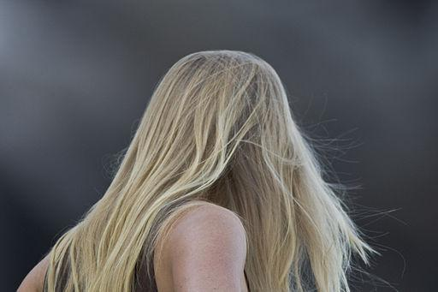
Dilemma at the movies
This person dropped their ticket in the hallway.
Do you call out
“Excuse me, ma’am!”
or
“Excuse me, sir!”
You have to make a guess.

Slide 6
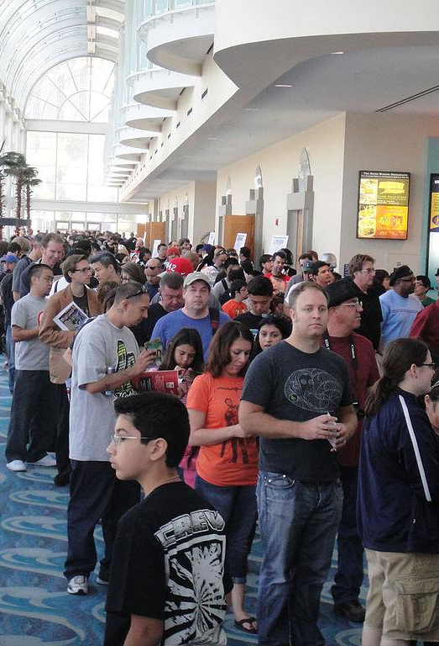
Dilemma at the movies
What if they’re standing in line for the men’s restroom?
Bayesian inference is a way to capture common sense.
It helps you use what you know to make better guesses.

Slide 7
Put numbers to our dilemma
Out of 100 women at the movies
Out of 100 men at the movies
50 have
short hair
50 have
long hair
96 have
short hair
4 have
long hair

Slide 8
Put numbers to our dilemma
Out of 100 women at the movies
Out of 100 men at the movies
50 have
short hair
50 have
long hair
96 have
short hair
4 have
long hair
About 12 times more women have long hair than men.

Slide 9
Put numbers to our dilemma
Out of 2 women
in line
Out of 98 men
in line
1 has
short hair
1 has
long hair
94 have
short hair
4 have
long hair
But there are 98 men and 2 women in line for the men’s restroom.

Slide 10
Put numbers to our dilemma
Out of 2 women
in line
Out of 98 men
in line
1 has
short hair
1 has
long hair
94 have
short hair
4 have
long hair
In the line, 4 times more men have long hair than women.

Slide 11
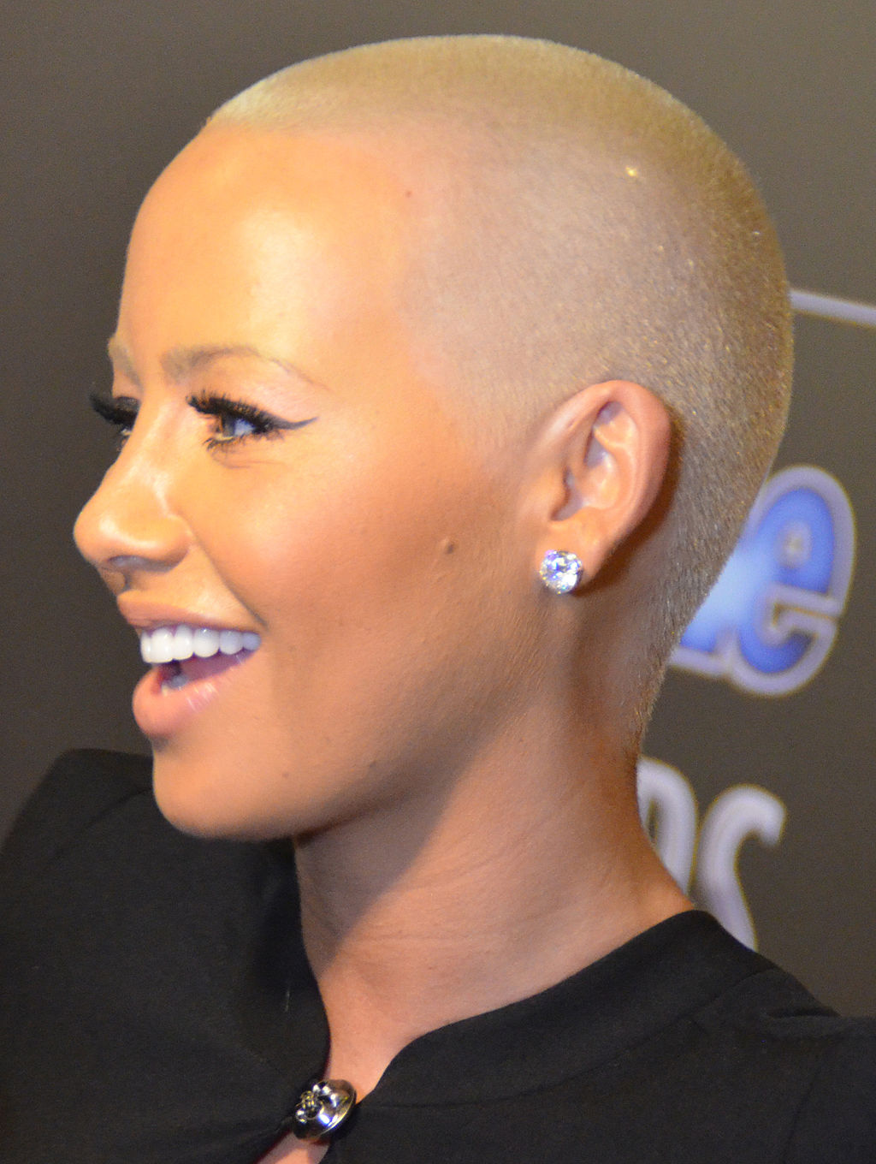
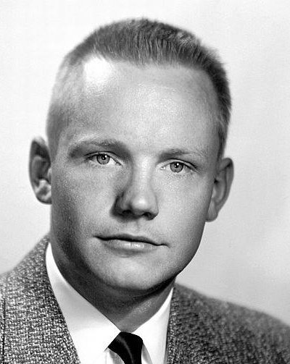
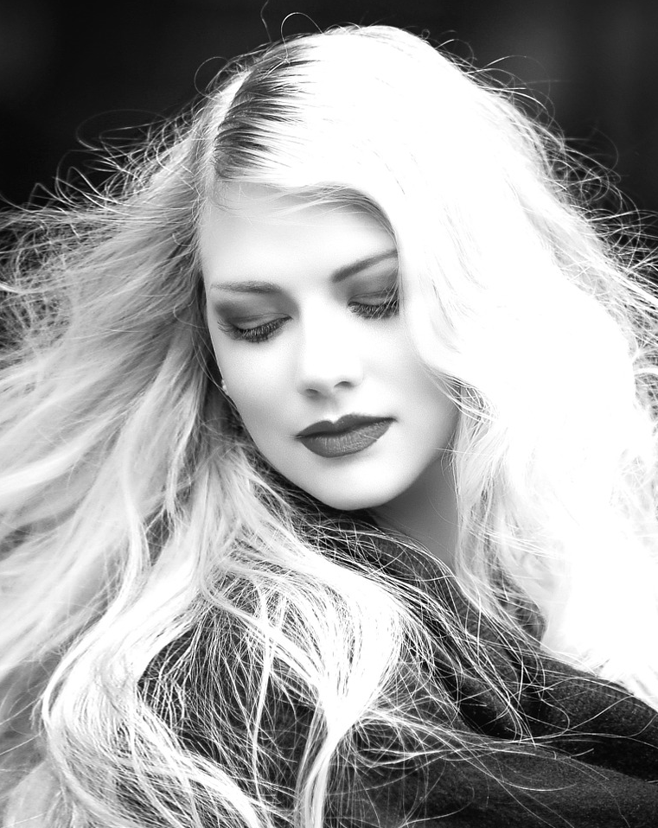
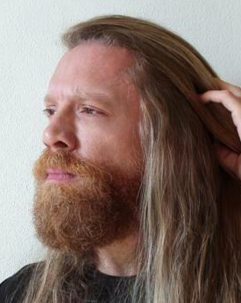
Out of 100 people at the movies
50 are women
50 are men
25 women
have
short hair
48 men
have
short hair
25 women
have
long hair
2 men have long hair

Slide 12
Out of 100 people
In line for the men’s restroom
2 are
women
98 are men
One
woman
has
short
hair
94 men
have
short hair
One
woman
has
long
hair
4 men have long hair

Slide 13
Translate to math
Out of 100 people at the movies
50 are women
50 are men
P(something) = # something / # everything
P(woman) = Probability that a person is a woman
= # women / # people
= 50 / 100 = .5
P(man) = Probability that a person is a man
= # men / # people
= 50 / 100 = .5

Slide 14
Translate to math
Out of 100 people
In line for the men’s restroom
2 are
women
P(something) = # something / # everything
P(woman) = Probability that a person is a woman
= # women / # people
= 2 / 100 = .02
P(man) = Probability that a person is a man
= # men / # people
= 98 / 100 = .98
98 are men

Slide 15
Conditional probabilities
Out of 100 people at the movies
P(long hair | woman)
If I know that a person is a woman, what is the probability that person has long hair?
P(long hair | woman)
= # women with long hair / # women
= 25 / 50 = .5
50 are women
25 women
have
short hair
25 women
have
long hair

Slide 16
Conditional probabilities
Out of 100 people
In line for the men’s restroom
2 are
women
This doesn’t change when we consider people in line.
P(long hair | woman)
= # women with long hair / # women
= 1 / 2 = .5
One
woman
has
short
hair
One
woman
has
long
hair

Slide 17
Conditional probabilities
Out of 100 people at the movies
If I know that a person is a man, what is the probability that person has long hair?
P(long hair | man)
= # men with long hair / # men
= 2 / 50 = .04
Whether in line or not.
50 are men
48 men
have
short hair
2 men have long hair

Slide 18
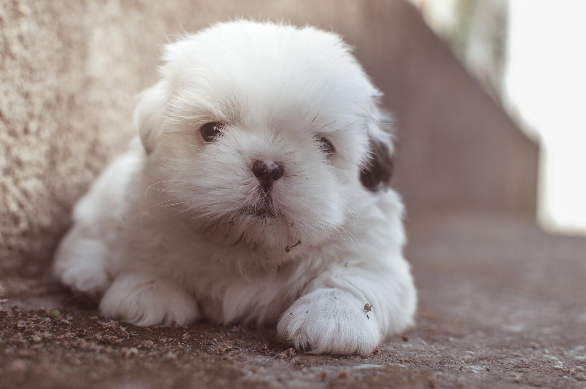
Conditional probabilities
P(A | B) is the probability of A, given B.
“If I know B is the case, what is the probability that A is also the case?”
P(A | B) is not the same as P(B | A).
P(cute | puppy) is not the same as P(puppy | cute)
If I know the thing I’m holding is a puppy, what is the probability that it is cute?
If I know the the thing I’m holding is cute, what is the probability that it is a puppy?

Slide 19
Joint probabilities
Out of probability of 1
What is the probability that a person is both a woman and has short hair?
P(woman with short hair)
= P(woman) * P(short hair | woman)
= .5 * .5 = .25
P(woman) = .5
P(man) = .5
P(woman with short hair) = .25

Slide 20
Joint probabilities
Out of probability of 1
P(woman with long hair)
= P(woman) * P(long hair | woman)
= .5 * .5 = .25
P(woman) = .5
P(man) = .5
P(woman with short hair) = .25
P(woman with long hair) = .25

Slide 21
Joint probabilities
Out of probability of 1
P(man with short hair)
= P(man) * P(short hair | man)
= .5 * .96 = .48
P(woman) = .5
P(man) = .5
P(woman with short hair) = .25
P(man with short hair) = .48
P(woman with long hair) = .25

Slide 22
Joint probabilities
Out of probability of 1
P(man with long hair)
= P(man) * P(long hair | man)
= .5 * .04 = .02
P(woman) = .5
P(man) = .5
P(woman with short hair) = .25
P(man with short hair) = .48
P(woman with long hair) = .25
P(man with long hair) = .02

Slide 23
Joint probabilities
Out of probability of 1
If P(man) = .98 and P(woman) = .02, then the answers change.
P(man with long hair)
= P(man) * P(long hair | man)
= .98 * .04 = .04
P(woman) = .02
P(man) = .98
P(woman
with short
hair) = .01
P(man with short hair) = .94
P(woman
with long
hair) = .01
P(man with long hair) = .04

Slide 24
Joint probabilities
Out of probability of 1
P(woman with long hair)
= P(woman) * P(long hair | woman)
= .02 * .5 = .01
P(woman) = .02
P(man) = .98
P(woman
with short
hair) = .01
P(man with short hair) = .94
P(woman
with long
hair) = .01
P(man with long hair) = .04

Slide 25
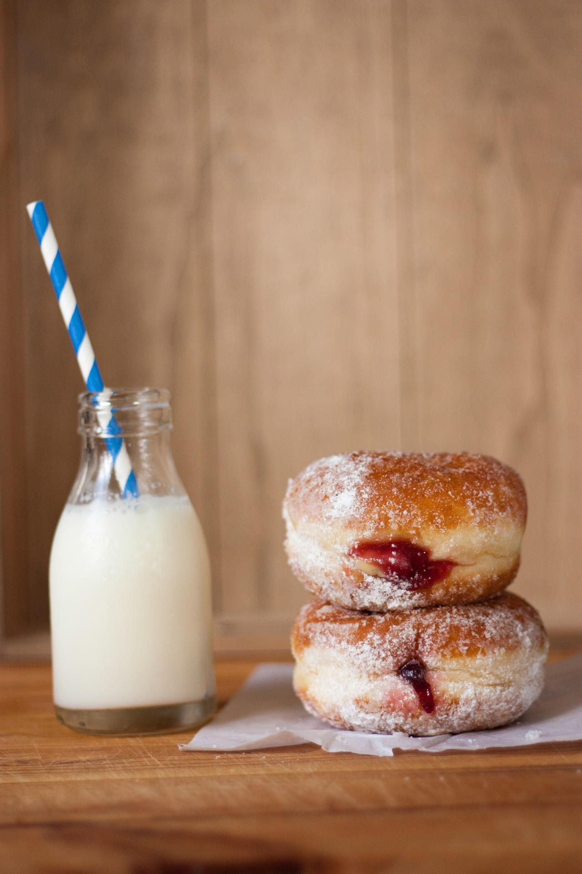
Joint probabilities
P(A and B) is the probability that both A and B are the case.
Also written P(A, B) or P(A ∩ B)
P(A and B) is the same as P(B and A)
The probability that I am having a jelly donut with my milk is the same as the probability that I am having milk with my jelly donut.
P(donut and milk) = P(milk and donut)

Slide 26
Marginal probabilities
Out of probability of 1
P(long hair) = P(woman with long hair) +
P(man with long hair)
= .01 + .04 = .05
P(woman) = .02
P(man) = .98
P(woman
with short
hair) = .01
P(man with short hair) = .94
P(woman
with long
hair) = .01
P(man with long hair) = .04

Slide 27
Marginal probabilities
Out of probability of 1
P(short hair) = P(woman with short hair) +
P(man with short hair)
= .01 + .94 = .95
P(woman) = .02
P(man) = .98
P(woman
with short
hair) = .01
P(man with short hair) = .94
P(woman
with long
hair) = .01
P(man with long hair) = .04

Slide 28
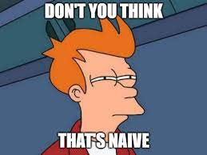

Slide 29
What we really care about
We know the person has long hair. Are they a man or a woman?
P(man | long hair)
We don’t know this answer yet.

Slide 30
Thomas Bayes noticed something cool
P(man with long hair) = P(long hair) * P(man | long hair)

Slide 31
Thomas Bayes noticed something cool
P(man with long hair) = P(long hair) * P(man | long hair)
P(long hair and man) = P(man) * P(long hair | man)

Slide 32
Thomas Bayes noticed something cool
P(man with long hair) = P(long hair) * P(man | long hair)
P(long hair and man) = P(man) * P(long hair | man)
Because P(man and long hair) = P(long hair and man)

Slide 33
Thomas Bayes noticed something cool
P(man with long hair) = P(long hair) * P(man | long hair)
P(long hair and man) = P(man) * P(long hair | man)
Because P(man and long hair) = P(long hair and man)
P(long hair) * P(man | long hair) = P(man) * P(long hair | man)

Slide 34
Thomas Bayes noticed something cool
P(man with long hair) = P(long hair) * P(man | long hair)
P(long hair and man) = P(man) * P(long hair | man)
Because P(man and long hair) = P(long hair and man)
P(long hair) * P(man | long hair) = P(man) * P(long hair | man)
P(man | long hair) = P(man) * P(long hair | man) / P(long hair)

Slide 35
Thomas Bayes noticed something cool
P(man with long hair) = P(long hair) * P(man | long hair)
P(long hair and man) = P(man) * P(long hair | man)
Because P(man and long hair) = P(long hair and man)
P(long hair) * P(man | long hair) = P(man) * P(long hair | man)
P(man | long hair) = P(man) * P(long hair | man) / P(long hair)
P(A | B) = P(B | A) * P(A) / P(B)

Slide 36
Bayes’ Theorem
P(A | B) = P(B | A) P(A)
P(B)

Slide 37
Back to the movie theater, this time with Bayes
P(man | long hair) = P(man) * P(long hair | man)
P(long hair)
P(woman) = .5
P(man) = .5
P(long hair | man) = .04
P(long hair | woman) = .5

Slide 38
Back to the movie theater, this time with Bayes
P(man | long hair) = P(man) * P(long hair | man)
P(long hair)
= P(man) * P(long hair | man)
P(woman with long hair) + P(man with long hair)
P(woman) = .5
P(man) = .5
P(long hair | man) = .04
P(long hair | woman) = .5

Slide 39
Back to the movie theater, this time with Bayes
P(man | long hair) = P(man) * P(long hair | man)
P(long hair)
P(man) * P(long hair | man)
= P(woman with long hair) + P(man with long hair)
P(man | long hair) = .5 * .04 = .02 / .27 = .07
.25 + .02
P(woman) = .5
P(man) = .5
P(long hair | man) = .04
P(long hair | woman) = .5

Slide 40
Back to the movie theater, this time with Bayes
P(man | long hair) = P(man) * P(long hair | man)
P(long hair)
= P(man) * P(long hair | man)
P(woman with long hair) + P(man with long hair)
P(woman) = .02
P(man) = .98
P(long hair | man) = .04
P(long hair | woman) = .5

Slide 41
Back to the movie theater, this time with Bayes
P(man | long hair) = P(man) * P(long hair | man)
P(long hair)
= P(man) * P(long hair | man)
P(woman with long hair) + P(man with long hair)
P(man | long hair) = .98 * .04 = .04 / .05 = .80
.01 + .04
P(woman) = .02
P(man) = .98
P(long hair | man) = .04
P(long hair | woman) = .5

Slide 42
Bayes’ Theorem
P(A | B) = P(B | A) P(A)
P(B)P(B)

Slide 43
Bayes’ Theorem
P(w | m) = P(m | w) P(w)
P(m)P(m)

Slide 44
Bayes’ Theorem
P(w | m) = P(m | w) P(w)
P(m)
prior

Slide 45
Bayes’ Theorem
P(w | m) = P(m | w) P(w)
P(m)P(m)
likelihood

Slide 46
Bayes’ Theorem
P(w | m) = P(m | w) P(w)
P(m)
posterior

Slide 47
Bayes’ Theorem
P(w | m) = P(m | w) P(w)
P(m)
marginal likelihood

Slide 48
What Are the Basic Assumption?
Features Are Independent

Slide 49
Advantages of Naïve bayes
Work Very well with many number of features
Works Well with Large training Dataset
It converges faster when we are training the model
It also performs well with categorical features

Slide 50

Disadvantages
Correlated features affects performance

Slide 51

Hyper Parameters tuning

Slide 52
